Slide 1

Project : Instagram User Analytics
Submitted By : Miss Aishwarya Ganapat Desai.

Slide 2
Contents:
Project Overview
Project Description
Approach
Tech-Stack Used
Insights
Result
Drive Link

Slide 3
Project Overview:
Project Overview: Exploring Instagram User Interactions for Informed Decision-Making
In this project, my role as a data analyst is like collaborating closely with Instagram's product team.
The core goal of this project revolves around deriving meaningful insights from user interactions and engagement data within the Instagram application.
Leveraging MySQL Workbench, the project strives to reveal underlying patterns, emerging trends, and user behaviors, ultimately furnishing actionable intelligence to inform and steer the company's strategies for sustainable growth.

Slide 4
Project Description:
1. Purpose:
The central aim of this project is to harness the power of data analysis techniques and SQL expertise to delve into the intricacies of user interactions and engagement with the Instagram application.
Our overarching goal is to cultivate a profound understanding of user behavior, thereby furnishing invaluable insights that will serve as a compass for decision-making across various organizational departments, encompassing marketing, product development, and the enhancement of user experience. Through meticulous scrutiny of the data, our endeavor is to unearth underlying patterns, emergent trends, and user preferences that will play an instrumental role in steering the strategic growth and continual refinement of the Instagram app.

Slide 5
2. Approach :
The key components of this project involves following things:
1. Data Collection and Preparation
2. Database Design
3.SQL Querying and Analysis
4.User Behavior Patterns
5.User Experience Improvement
6.Data Reporting
7.Strategic Decision-Making

Slide 6
Tech-Stack Used:
The entire project was executed meticulously within MySQL Workbench, with a specific focus on version 8.0.34. MySQL Workbench stands as the designated and user-friendly graphical user interface (GUI) tool for proficiently managing MySQL databases, rendering it the optimal selection for this project.
This robust tool streamlined the processes of data extraction, SQL query composition, and data visualization, thereby facilitating a comprehensive exploration of user engagement patterns. Leveraging its intuitive interface, the project team effectively harnessed the capabilities of MySQL Workbench to extract and distill meaningful insights. These insights, in turn, played a pivotal role in guiding strategic decisions aimed at enhancing the user experience of the Instagram app and fostering its growth.

Slide 7
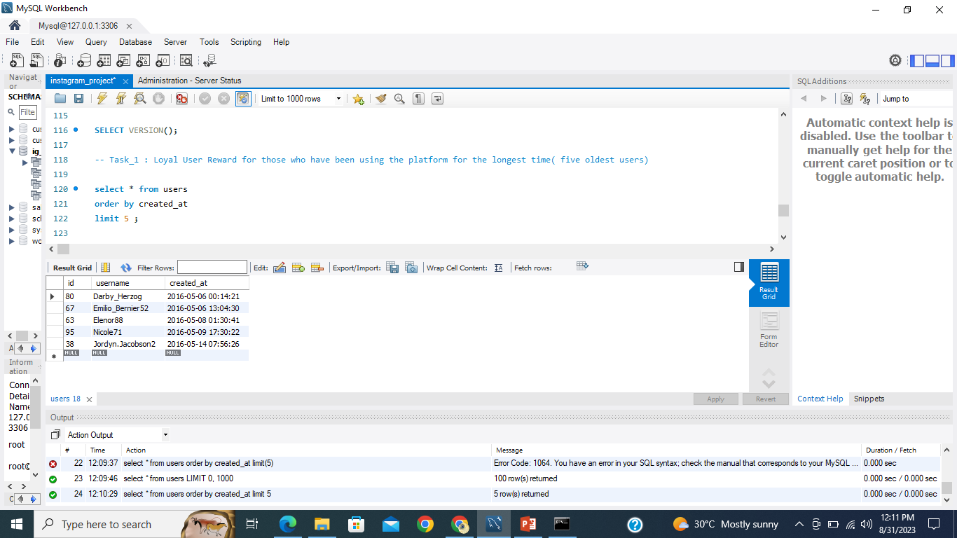
A) Marketing Analysis: Insights
Loyal User Reward for those who have been using the platform for the longest time. That is to identify the five oldest users on Instagram from the database.
Here we have got top five oldest user information, And the names of users are:
Darby_Herzog, Emilio_Bernier52, Elenor88, Nicole71 and Jordyn.Jacobson2.

Slide 8
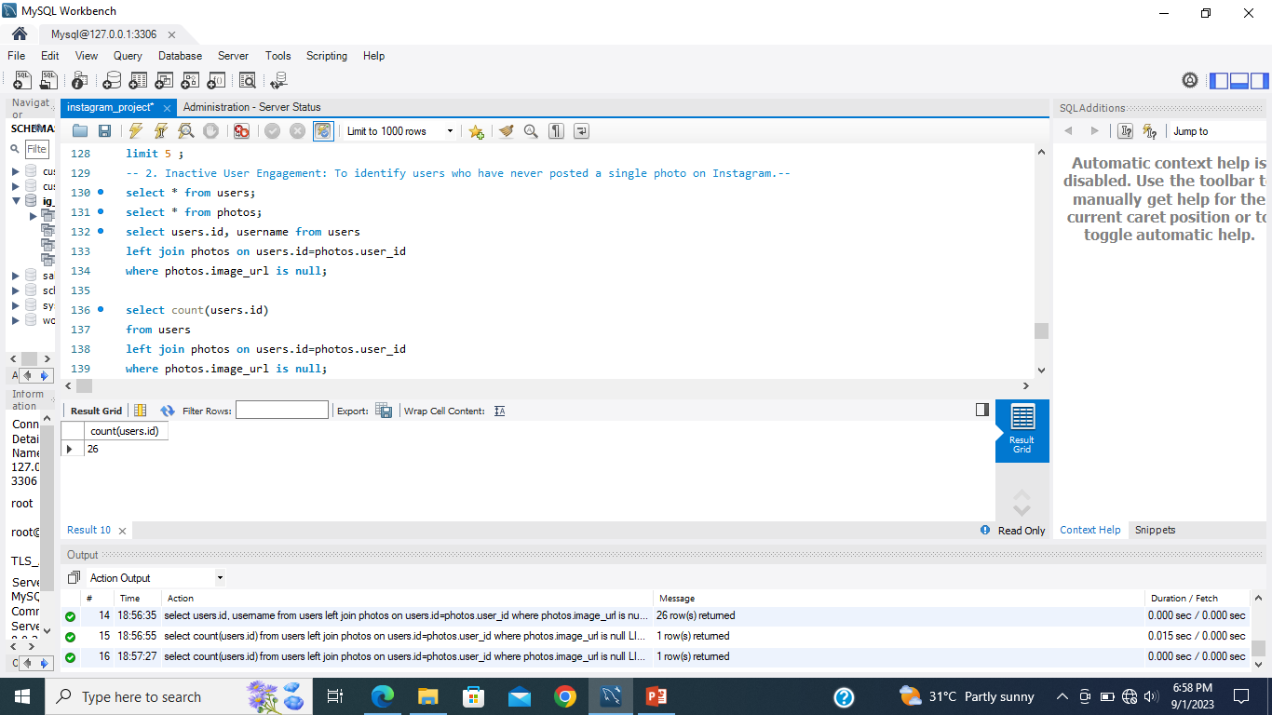
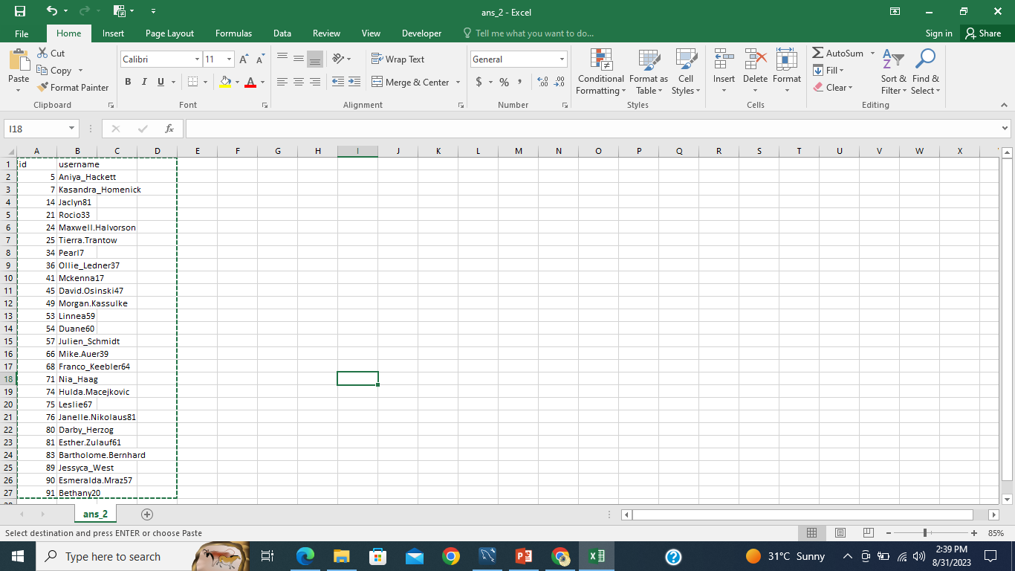
2. Inactive User Engagement: To identify users who have never posted a single photo on Instagram.
Here we have total 26 users and their names who have never posted a single
photo on Instagram. So using this information, the team can encourage these
inactive users to start posting by sending them promotional emails very easily.

Slide 9
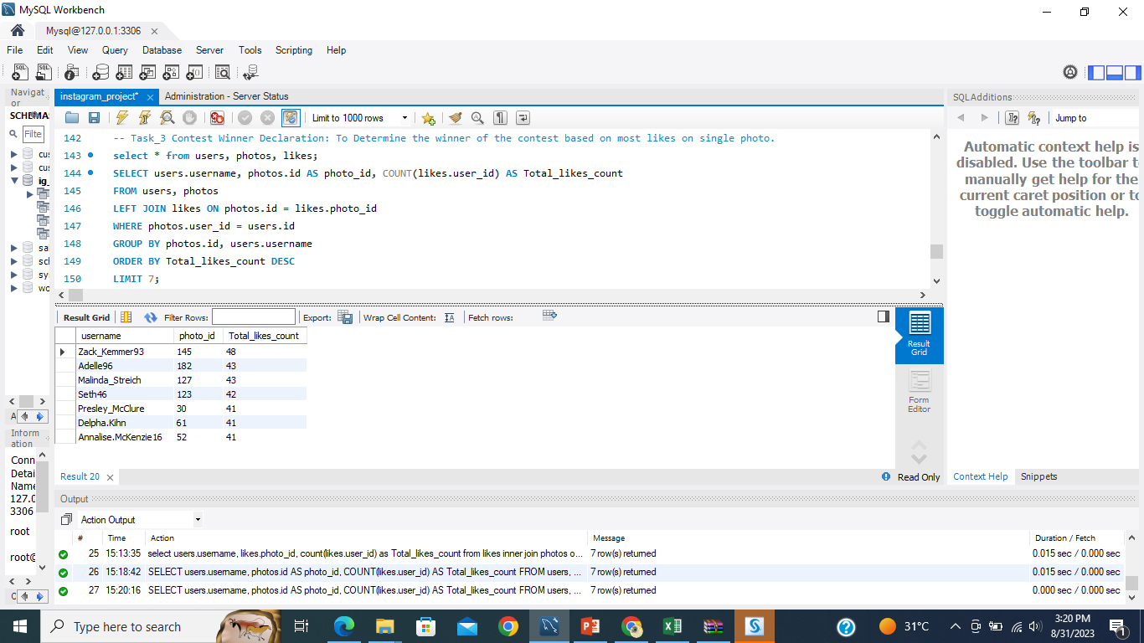
3. Contest Winner Declaration: To Determine the winner of the contest based on most likes on single photo.
Here we have the top 7 users who has most likes on their single photo with respective count of their likes.
Amoung these 7 users The Zack_Kemmer93 has highest likes. So we can say that he must be the contest winner for having highest likes.

Slide 10
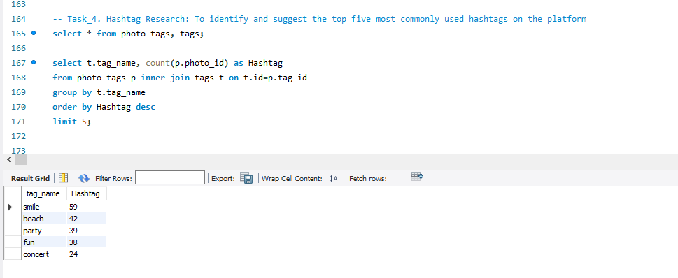
4. Hashtag Research: To identify and suggest the top five most commonly used hashtags on the platform.
The above result gives the top five mostly used hashtags, which are smile, beach, party, fun, and concert and their respective counts.

Slide 11
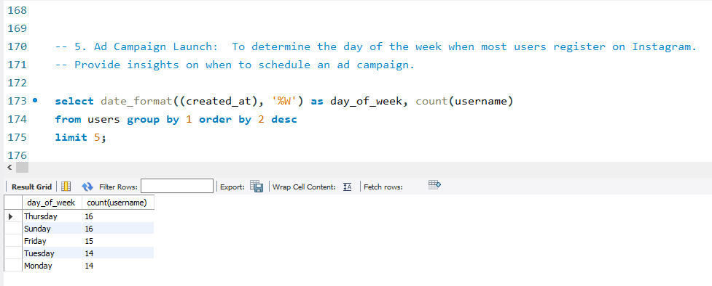
5. Ad Campaign Launch: To determine the day of the week when most users register on Instagram. Provide insights on when to schedule an ad campaign.
From the above result we can say that among the all days Thursday and Sunday are the days on which the registration is higher. And hence we can schedule an ad campaign on both these days.

Slide 12
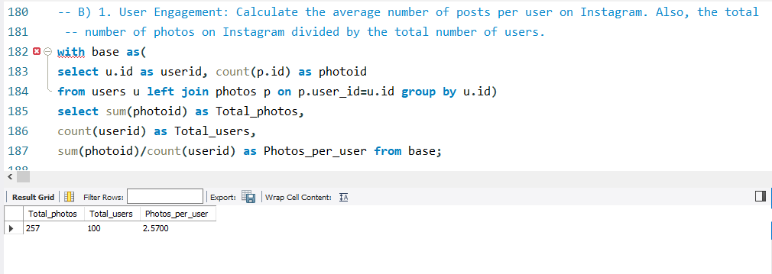
B) Investor Metrics: Insights
1. User Engagement: Calculate the average number of posts per user on Instagram. Also, the total number of photos on Instagram divided by the total number of users.
From above result we can see that there are total 257 photos have been uploaded by100 users. So the photos per user would be 2.57

Slide 13
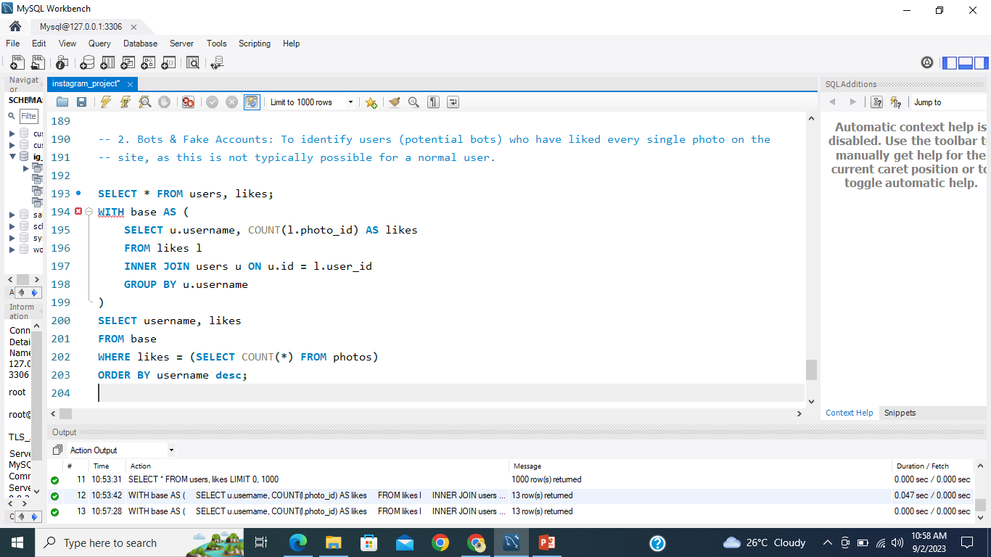
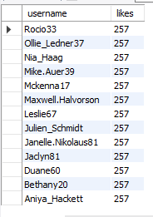
2. Bots & Fake Accounts: To identify users (potential bots) who have liked every single photo on the site, as this is not typically possible for a normal user.
From above result we can say, there are total 13 users, who are fake based on their number of likes on photos.

Slide 14
Results
I found this project very helpful to better understand, how to work on data and get useful insights from it using MY SQL.
All the requirements got satisfied and the insights which drawn from it are as follows:
A) Marketing Anlysis:
1. We identified the top five oldest users to consider for the Loyal User Reward program.
2. There are 26 users who have never posted a single photo on the platform, and we plan to encourage them to start posting by sending promotional emails.
3. The user "Zack_Kemmer93" has the highest number of likes among the top 7 users, making him the contest winner for the highest likes.
4. The top five mostly used hashtags are "smile," "beach," "party," "fun," and "concert," along with their respective counts.
5. Thursday and Sunday have the highest registration rates, suggesting that scheduling ad campaigns on these days may lead to higher user acquisition.
A) Investor Metrics:
1. A total of 257 photos have been uploaded by 100 users.
2. We have identified 13 users who are potentially fake based on their patterns of liking photos.

Slide 15
Conclusion
Based on the insights and results we have got in analysis, we have a clear understanding of user behavior and platform metrics.
We can use this information to shape our marketing strategies, content creation, and ad campaign scheduling.
Additionally, we have taken steps to address fake users, ensuring the integrity of our user community. These efforts are aimed at driving the growth and success of our platform.

